Slide 1

5.1.1
Vector

Slide 2
Vectors VS Scalars
：
Example of vectors
Force、velocity、acceleration、displacement 、moment、field，…
Example of Scalars
mass、temperature、length、density、time…

Slide 3
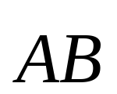





Representing a vector
Terminal
Initial point

Slide 4
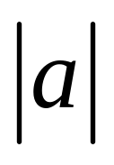

The magnitude or length of a vector
The magnitude or length of a vector

Slide 5

Two features of a vector
（1）direction；
（2）length
Translation of vectors

Slide 6
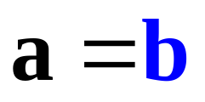

a ＝ b if and only if the length of a is equal to the length of b, and they have the same direction
They are parallel to each to other

Slide 7

the negative of a vector
The negative vector of a vector a is denoted by -a, its direction is opposite of a

Slide 8
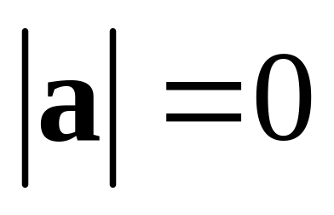
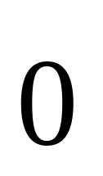
the zero vector
Length is 0
Denoted by
direction？
Any direction or no direction！

Slide 9
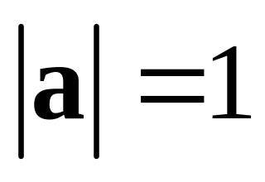

the unit vector
Length is 1 ：

Slide 10
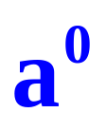
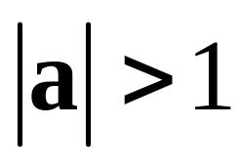
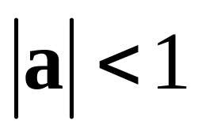
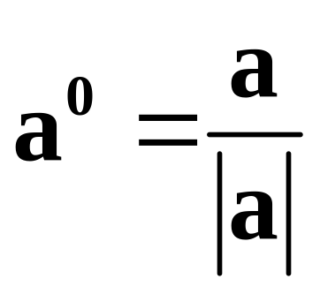
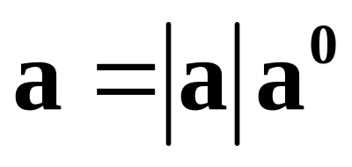
The unit vector in the direction of a is denoted by a⁰
a⁰ is the unit vector in the direction of a
Obviously
or

Slide 11




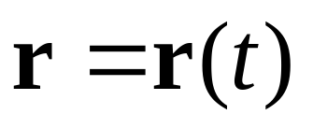
the position vector
The initial point is the origin

Slide 12
Vector function
Continuity? Derivative, integration?
Many applications in Engineering
Self-study? ！

Slide 13
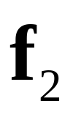
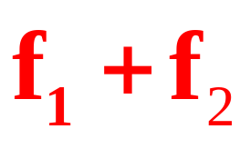
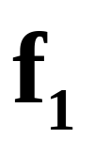
Adding two vectors
Resultant Force?

Slide 14
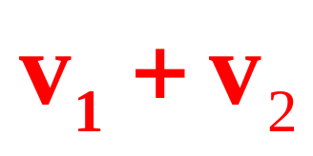
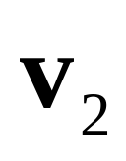
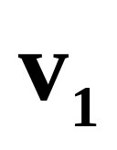
Adding two vectors
Velocities
Actual velocity
Velocity of the water
Velocity of the boat

Slide 15
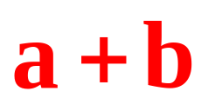

Vector Addition
Sum of vectors a and b
The Parallelogram Law

Slide 16
Vector Addition
Sum of vectors a and b
The Triangle Law/Rule

Slide 17
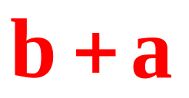
Properties of Vector Addition
a+b = b+a Commutative Law

Slide 18
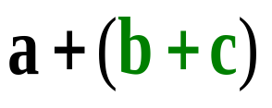

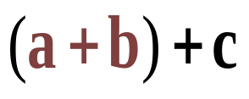
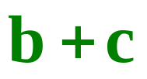

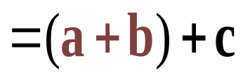
Properties of Vector Addition
a+(b＋c) = (a＋b)＋c Associative Law

Slide 19

a+(b＋c) = (a＋b)＋c
Polygon Rule

Slide 20
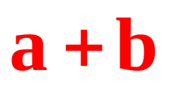
Adding two parallel vectors

Slide 21
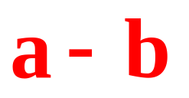
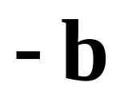
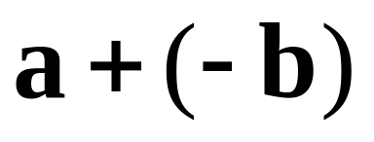
Subtraction
Difference of vectors a and b:
a - b = a + (-b)
Triangle Law

Slide 22
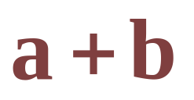
Diagonals of the parallelogram

Slide 23
5.1.3
Scalar Multiplication

Slide 24
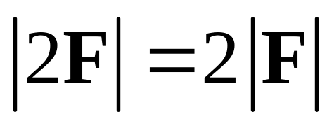

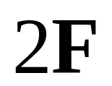
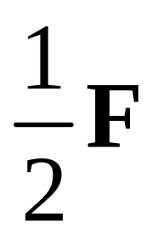
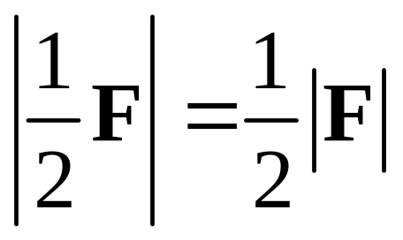
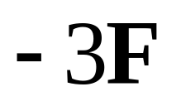
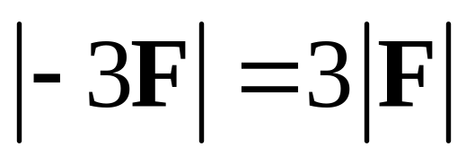
Scalar multiplication

Slide 25
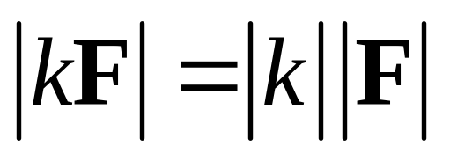
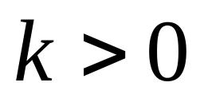
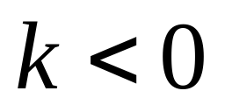
Same direction
Opposite direction

Slide 26
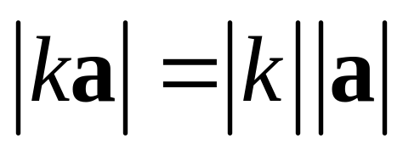
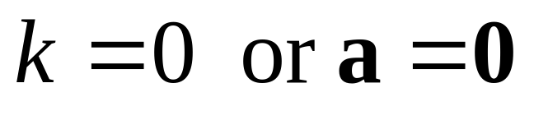
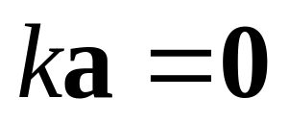
The vector ka：
Length
Direction：
ka and a have same direction
ka and a have opposite direction

Slide 27
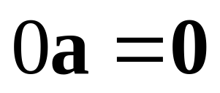
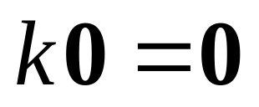
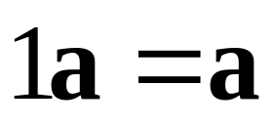
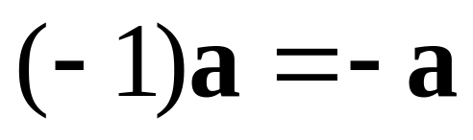
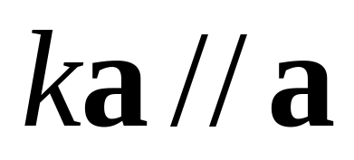
Properties of Scalar Multiplication：
Note
ka and a are parallel

Slide 28
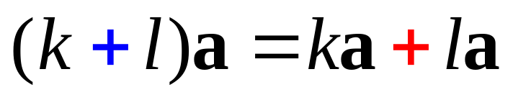
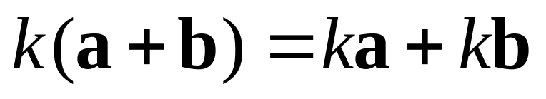
Properties of Scalar Multiplication
(1) ka=ak
Commutative law
(2) k(la)=(kl)a
Associative Law
(3)
Distributive Law

Slide 29

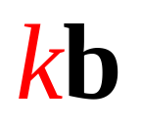
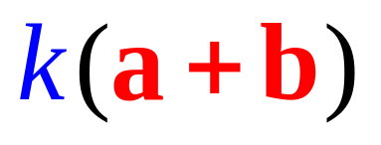


所以

Slide 30




Linearity properties of vectors
Linear combination
d is a linearly combination of a, b and c

Slide 31
a is parallel to b if and only if there is a number k such that a=kb
This means that they are linearly dependent.
If they are not parallel to each other, they are linearly independent.

Slide 32






If
Then vector c is a linear combination of a and b if a, b c are coplanar.
The plane is spanned by the vector a and b
2-Dimension

Slide 33







If
are not coplanar
Then and any vector d in 3-D, is a linear combination of a, b and c. i.e. d = la + mb＋nc
The space is spanned by the three vectors a, b and c
3-Dimension

